Slide 1
How AI Will Change Advertising As We Know It
Jonathan Opdyke
Chief Strategy Officer, Criteo

Slide 2

Notes:
The first scenario is optimism. We can think about “Star Trek” here, where our technology has gotten so advanced that humanity is allowed to explore new worlds. Human society is united by technology and space exploration. Money no longer exists.

Slide 3
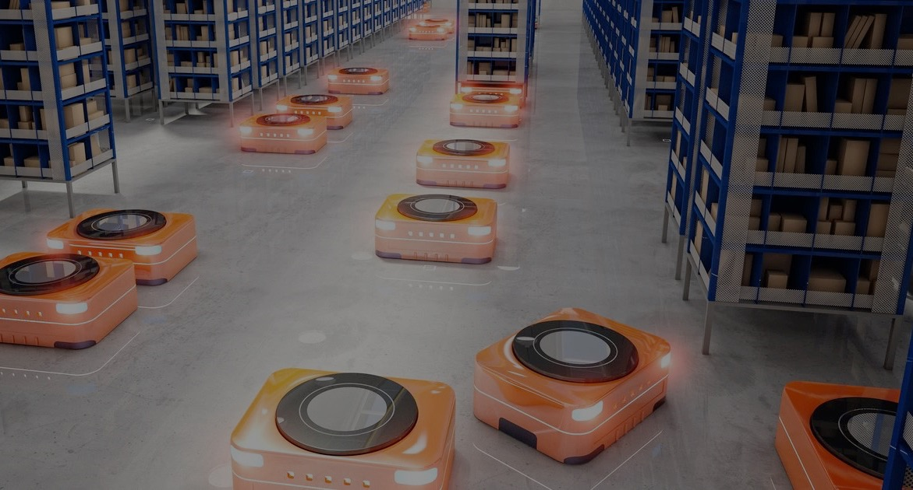

Notes:
The second scenario is automation, which has been explored by countless movies and novels. Take Kurt Vonnegut’s Player Piano, which described a world where machines take over all of the labor, displacing workers and dividing society.

Slide 4

Notes:
The third scenario, I think we all have in the back of our minds, is some kind of AI apocalypse. Think of The Terminator, where artificial intelligence takes over completely and destroys the world as we know it.

Slide 5



The Future is Now
Notes:
For many years, it’s been easy to dismiss them as pure science fiction, at least well beyond our lifetimes.
But the reality is that a new future is emerging around us at a breakneck pace as computing power catches up to mathematical theory.
The future really is NOW.

Slide 6
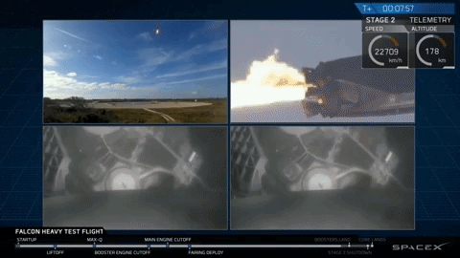
Notes:
We may not always recognize data when we see it.
But this year, we saw data break through the atmosphere. SpaceX didn’t launch a rocket – the company launched a robot that, incidentally, was also a rocket. By leveraging data and machine learning, SpaceX engineers taught the rocket boosters to come back to earth.

Slide 7
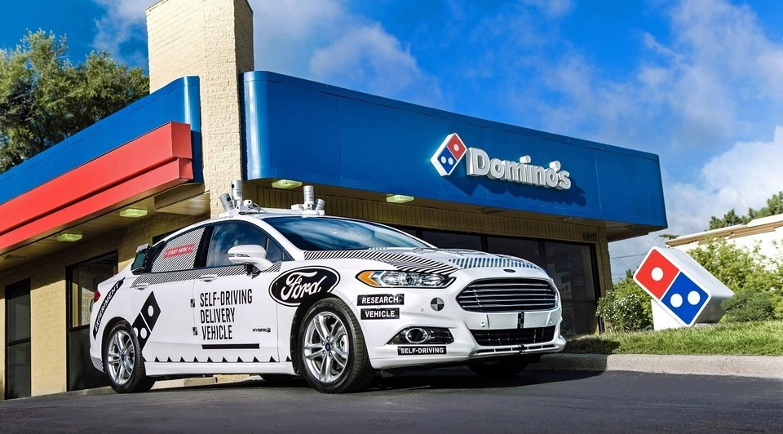
Notes:
Meanwhile, Ford is testing driverless pizza delivery in Miami, Florida. How does the car know where to go?
Well, the directions are all based on locational and GPS data that are processed by sophisticated machine learning.

Slide 8
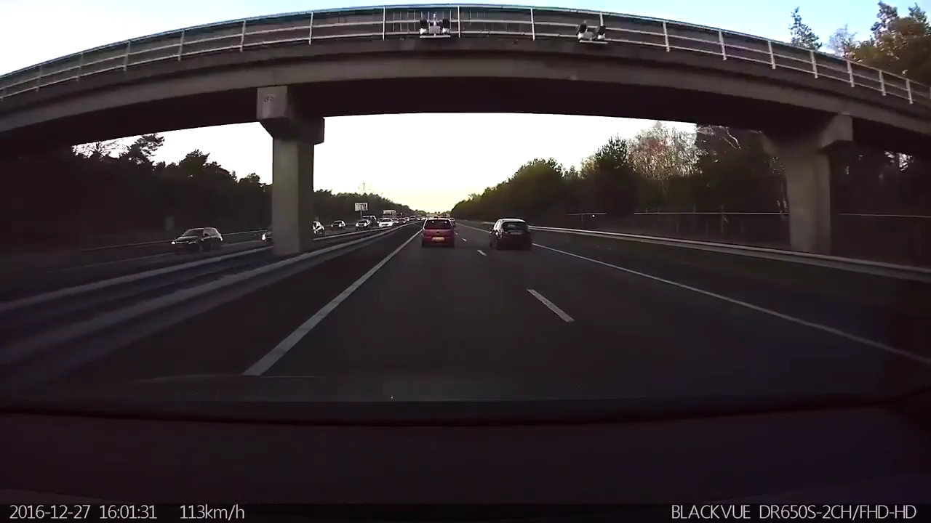
Notes:
This is a video of a Tesla car recognizing patterns and calculating the probability of an accident in milliseconds, and the reacting by slowing/stopping the car automatically.

Slide 9
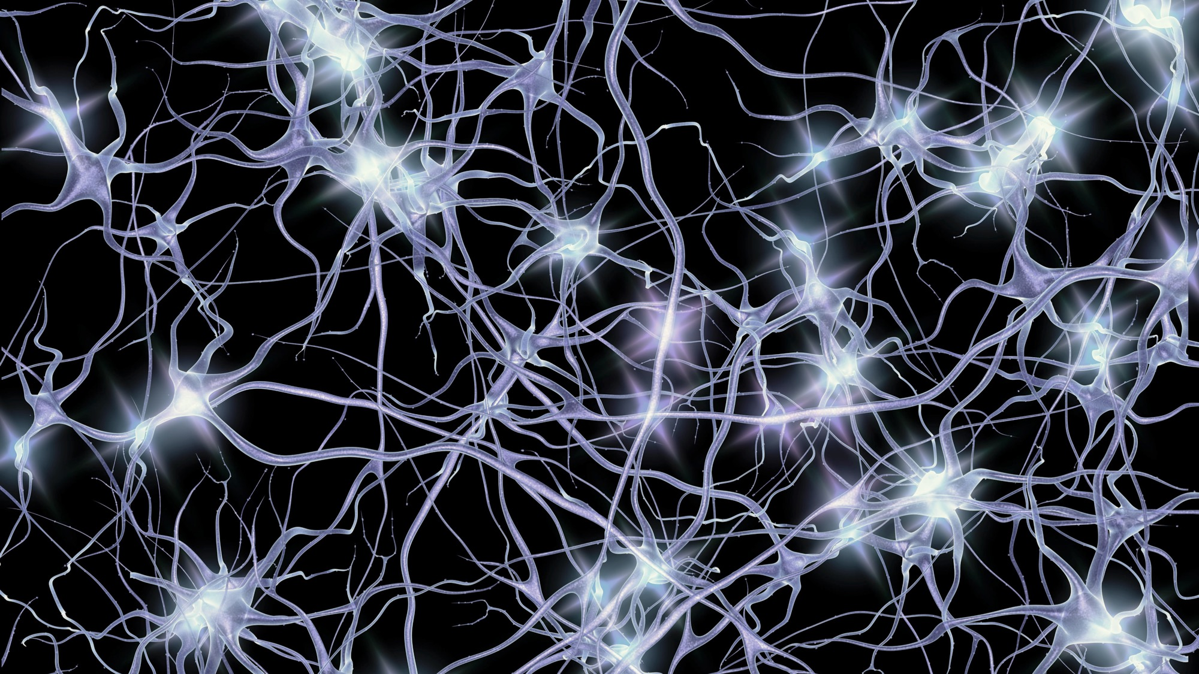
Notes:
The newest computing techniques are starting to resemble the neural networks of our brains, gathering massive amounts of data from various forms of sources and sensors (like our senses) and applying new types of algorithms that parse that data and look for signals, patterns and probabilities, then make decisions or predictions; many of which are not entirely black and white, rather grey or subjective like the output of our minds.

Slide 10

More data wins
Notes:
In other words… more data wins. The more data you have, the more signals and patterns the machine can infer at a higher confidence.

Slide 11

Notes:
So what does this have to do with Commerce Marketing and selling more products? Well the act of shopping actually generates incredible amounts of data, with varying degrees of structure, like many of the applications I just described. And the ability to predict what a shopper may do next is basically what all of us in the room have been trying to do for most of our careers.
Albeit with comparatively crude tools when you consider the emerging possibilities of artificial intelligence.

Slide 12

Notes:
Marketers started out with very basic ways to measure attention and ROI. Metrics like impressions told us that people saw our ads, but we didn’t have much more information than that. TV ads and print ads are even harder to track.

Slide 13
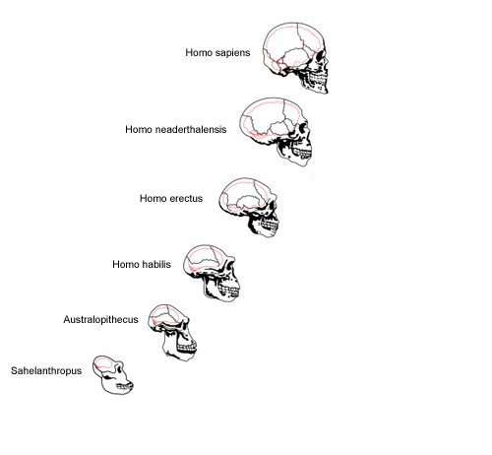
Notes:
But marketing has evolved and data is pushing us all forward.
Think of how humans evolved. As our brains got bigger, we became more complex. We gained the ability to store and process vast amounts of data and that led us to make better decisions, communicate, form relationships, build societies.

Slide 14




Notes:
If data resembles a neural network, that brain, too, continues to grow. And in the evolution of marketing, the biggest brain will win.
Together, Amazon, Facebook, and Google have built vast data sets that have allowed them to outpace the competition.
Google and Facebook services now account for 70% of Internet traffic, including mobile. Google search, YouTube, Google Maps, Facebook, Facebook Messenger, WhatsApp, Instagram are all services that belong to two very distinct ecosystems.
Amazon now accounts for roughly half of US ecommerce purchases. In the UK, the company reached 6.3 billion pounds in annual revenue.
The disparity between the scale of data and AI capabilities of these companies and most marketers is stark. And, with so much revenue, these tech giants can invest in more technology and infrastructure.

Slide 15

Notes:
These companies own all of these interactions – and the shopper data behind them. So brands retailers work with the tech giants to better target their own audiences, but there’s no ownership involved. Instead, you’re renting the data and renting the relationships.

Slide 16
CMO Survey: Walled garden concerns
50%
41%
38%
Limit access to their own products
Limit access to information about their customers and products
Enable the garden owner to dictate terms & service
Source: The Commerce Data Opportunity, Forbes Insights / Criteo research, Q3 2017.
Notes:
CMOs are wary of walled gardens.
In our research with Forbes Insights, half of the CMOs interviewed said that they’re concerned that walled gardens limit their access to data about their own products. 41% feel the same way about their access to customer data.
So if data is really the foundation of business today, but someone else is accruing all the data, how do you win?

Slide 17

Notes:
The reality is it will be difficult for any individual, independent retailer or brand to compete on their own. Your own data likely won’t be enough. Instead, we have to focus on collaboration to keep moving forward. By pooling data together, it’s possible to build data sets that can rival the biggest players in the space.

Slide 18
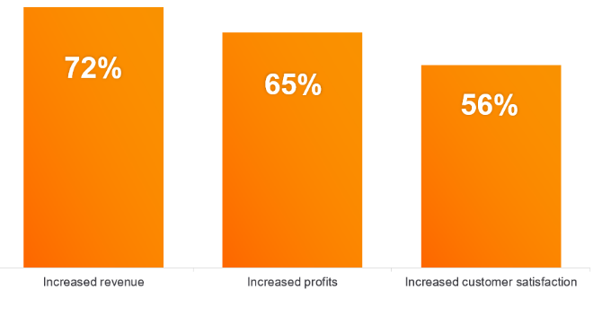

CMO Survey: Data pooling can lead to…
“
Source: The Data Commerce Opportunity, Forbes Insights & Criteo, 2017
Notes:
In our research with Forbes Insights, we discovered that 72% of CMOs believe that collaborating on data can lead to increased revenue. 65% believe that collaboration can lead to increased profits and 56% said they believe customer satisfaction would increase.
This could mean sharing data assets like online search, web usage, browsing behavior, and in-store and point of sale systems. By pooling them together, it’s possible for companies to compete for shopper attention and become less dependent on the tech giants.

Slide 19


Criteo can help level the playing field
Commerce Marketing Ecosystem
~$380 bn online sales
$670 bn online sales
across clients
Notes:
That’s where Criteo is focused today. We are building an open, collaborative ecosystem that levels the playing field for our clients and partners. We believe that, by voluntarily pooling non personally-identifiable data together, we can help retailers and brands alike tap into an unparalleled data set that allows them to personalize across every channel – not just inside a few walled gardens by its terms.

Slide 20
Criteo can help level the playing field
Commerce Marketing Ecosystem
~$400 bn
omnichannel sales
$ Trillions omnichannel sales
(potential to onboard)
Notes:
And when you think about the size, combining the offline impact, we actually have access to trillions of dollars in omnichannel sales. This is where we can win.

Slide 21
Collaboration for a deeper understanding of the shopper
Single Retailer
Shopper Graph
In past year:
27 online purchases
14 stores
95 products
24 brands
$3575 value
Frequent online shopper
Buys at full price
Strong affinity to 15 brands
Prefers high-end products
Buys clothing every month
3 favorite colors
2 favorite styles
Etc.
Online
Bought one pair of jeans 2 months ago for $71
Shopper
Profile
In past year:
75 offline purchases
28 stores
542 products
85 brands
$10,727 value
Offline
Bought one pair of shoes
6 months ago for $214
Notes:
With that data set and Criteo’s commerce marketing solutions, we can help retailers and brands leverage machine learning to create the AI-powered campaigns of tomorrow.
While a single retailer may have the data to create a profile about that shopper, the Criteo Shopper Graph, the foundation of our ecosystem, allows retailers far deeper insight.
Gender, frequency, price points, different colors and styles can all be learned and ads can be created and targeted accordingly.

Slide 22
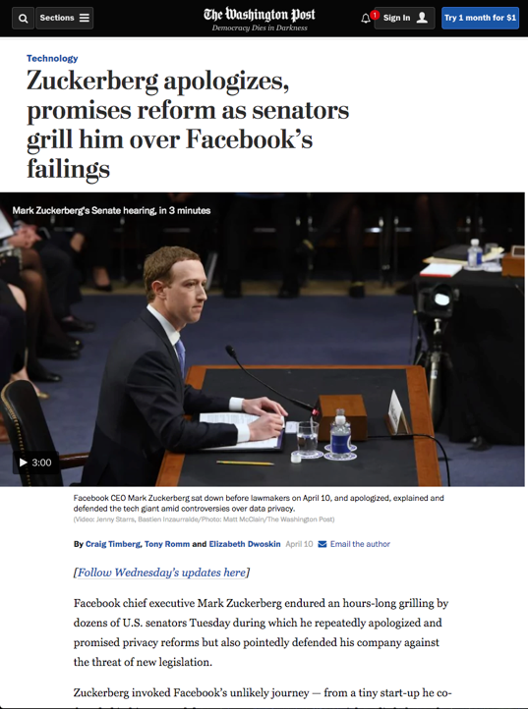
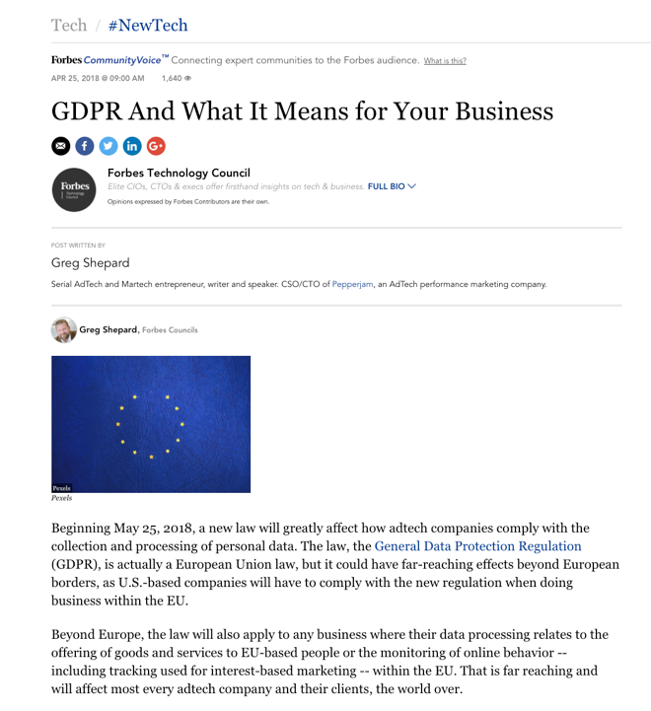
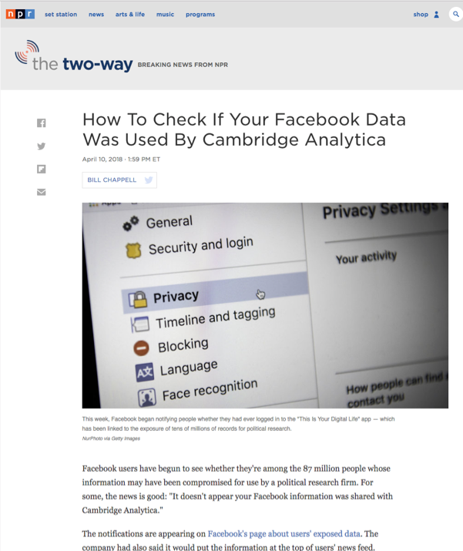
Notes:
Of course, with what’s going on today, from Cambridge Analytica and Zuck having to testify before Congress, to GDPR, data privacy is emerging as super important to consumers and governments. Criteo has always put data privacy out front, being the pioneer in ad choices to ensuring that our data is GDPR compliant.

Slide 23



Finding new audiences with AI & collaboration
Notes:
So what does all of this data and AI mean in reality? It means that we can help you find new audiences. Assume you have your small group of customers. What we can do by combining your data into our shopper graph is to find new audiences, expanding your reach with data.

Slide 24


Criteo Customer Acquisition^{BETA}
Determine desired new customer profile
Set acquisition goal
Deploy campaign
Notes:
Criteo Customer Acquisition, which is currently in beta, activates the data across the Criteo Commerce Marketing Ecosystem to find new customers that have never bought anything from your brand before.
By creating lookalike audiences with similar shopping behaviors, Criteo Customer Acquisition can target the best possible shoppers that are the most relevant to your business, with the highest propensity to buy.

Slide 25




Collaboration for a deeper understanding of a brand’s shoppers
Shopper
Graph
RETAILER 1
RETAILER 2
RETAILER 3 …
RETAILER 18000+
Brand
800+
Retailers
700+
Retailers
Notes:
How does this all work?
Well, by collaborating with the Criteo Commerce Marketing Ecosystem, you’re offered access to data far beyond what you have on your own.
With 800+ retailers contributing, the Shopper Graph understands your next best shoppers on an individual basis, and Criteo’s commerce marketing solutions can activate the data to give them the best possible experience.

Slide 26

Notes:
Criteo believes in the power of this data, the power of collaboration to connect and inspire shoppers by connecting them to what they need and love. And we hope to collaborate together in the future to make this happen.

